Slide 1
Section 7.2
Mutually Exclusive Events and Venn Diagrams

Slide 2
Complement Events:
The probability that an event will not occur is equal to its complement
ie: : the probability that event A will occur
: the probability that event A will not occur
Note: If two events are complements then:
i)
ii) the two events can not occur at the same time
The sum of their probability
will be equal to 100%
© Copyright all rights reserved to Homework depot: www.BCMath.ca

Slide 3
Ex: A number is chosen from 0 to 10, “A” is the event that an odd will be chosen. Find the probability of the complement of event “A”.
ii) “B” is the event that a prime number is chosen. Find the complement:
1 and zero are NOT prime numbers
© Copyright all rights reserved to Homework depot: www.BCMath.ca

Slide 4
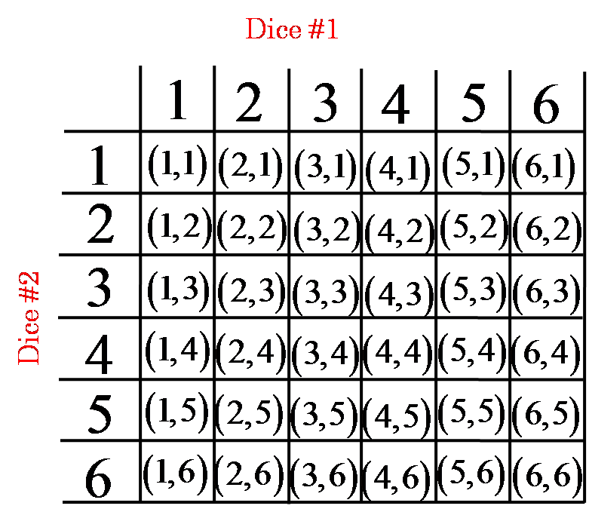
Ex: Two dice are rolled, find the probability of the complement
A: event that both dice are even
B: event that a sum greater than 8 is rolled
Probability that the both dice is not even
We can try finding P(A) first
Probability that the sum is not greater than 8
This means that the sum is
less than or equal to 8
© Copyright all rights reserved to Homework depot: www.BCMath.ca

Slide 5
Related Events with Venn Diagrams
Venn diagrams can be used to describe the sample space of an experiment
Everything in this circle is event A
Everything outside of this circle is the complement of A
Everything in the right circle is event B
Everything in both circles is known as “A or B”
Everything inside both circles at the same time is known as
“A and B”
© Copyright all rights reserved to Homework depot: www.BCMath.ca

Slide 6
Ex: Shade the venn diagrams for each of the following Probabilities
© Copyright all rights reserved to Homework depot: www.BCMath.ca

Slide 7
Mutually Exclusive Events:
Two events that can not occur at the same time are mutually exclusive
  Two events that don’t have any common outcomes
Mutually Exclusive
Not mutually exclusive
because they have some
common outcomes
They don’t have any common outcomes
© Copyright all rights reserved to Homework depot: www.BCMath.ca

Slide 8
Ex: Indicate which of the following events are mutually exclusive
i) A dice is rolled
A) an even number is rolled
B) an odd number is rolled
C) a “5” is rolled
D) a number less than 3 is rolled
Events A and B are Mutually Exclusive
Events C and D are M.E.
Events A and C are Mutually Exclusive
ii) A card is selected from a deck
A) Card is a club
B) A Face card is chosen
C) Card is red
D) A spade is chosen
E) An ace is chosen
Events A and C are Mutually Exclusive
Events C and D are M.E.
Events A and D are Mutually Exclusive
Events B and E are M.E.
© Copyright all rights reserved to Homework depot: www.BCMath.ca

Slide 9
Non-Mutually Exclusive Events
If two events are not mutually exclusive then:
Group the pieces back together
and the areas will be equal
Cancel each other out
The area of both circles combined is equal to:
Area of the red circle plus the area of the blue circle
subtract the common area in between
© Copyright all rights reserved to Homework depot: www.BCMath.ca

Slide 10

Ex: A card is chosen, what is the probability that the card is a spade or a royal card?
Practice: what is the probability that the card is less than 8 or a heart? (Ace is included)
© Copyright all rights reserved to Homework depot: www.BCMath.ca

Slide 11
Assume that all students must take Math & Science. The probability of passing a math test is 70% and the probability of passing a science test is 80%. The probability of passing both test is 65%. Find the probability of each event:
a) Student passes math but not science
b) Student does not pass both test
c) Student passes Math or Science
© Copyright all rights reserved to Homework depot: www.BCMath.ca

Slide 12
Ex: Two dice are rolled.
Event A – the sum of the dice is greater than 7
Event B – The product of dice is even
Find each of the following:
Include events ONLY in BOTH A and B
All the outcomes in event A and
all the outcomes in event B are included
© Copyright all rights reserved to Homework depot: www.BCMath.ca

Slide 13
Challenge: Two dice are rolled, what is the probability the following:
1st Find the probability
of getting a 2 or 6:
This includes any
outcome with a 2 or a 6:
The complement is this event is the probability of not “getting a 2 or 6”
1st Find the complement of each
event
Take out all events
with a two
Take out all events
with a six
includes all cases in both complements
© Copyright all rights reserved to Homework depot: www.BCMath.ca

Slide 14
Ex: The results from a marathon is recorded. 35% of the runners took more than 3 hours, 40% less than 2 hours, and 10% finished within 1 hour. Find the probability of the following:
i) A runner takes between
one and two hours
ii) A runner takes between
two and three hours
© Copyright all rights reserved to Homework depot: www.BCMath.ca

Slide 15
Challenge: How many words of length 5 using the letters A, B, C, D, and E have atleast one A and one B?
Use Venn Diagrams when solving this problem
This box represents all the 5 letter words
that are possible with ABCDE
First find all the words with NO A’s
Next find all the words with NO B’s
Now find the over lapping part with No A’s
And No B’s
Now use the venn diagram to get the complement, atleast one A and
one B.

Slide 16
10 people play in a tournament where every player is to play every other player once. If each

